Slide 1


Data Visualization Project
Credit Card User Attrition Analysis

Slide 2
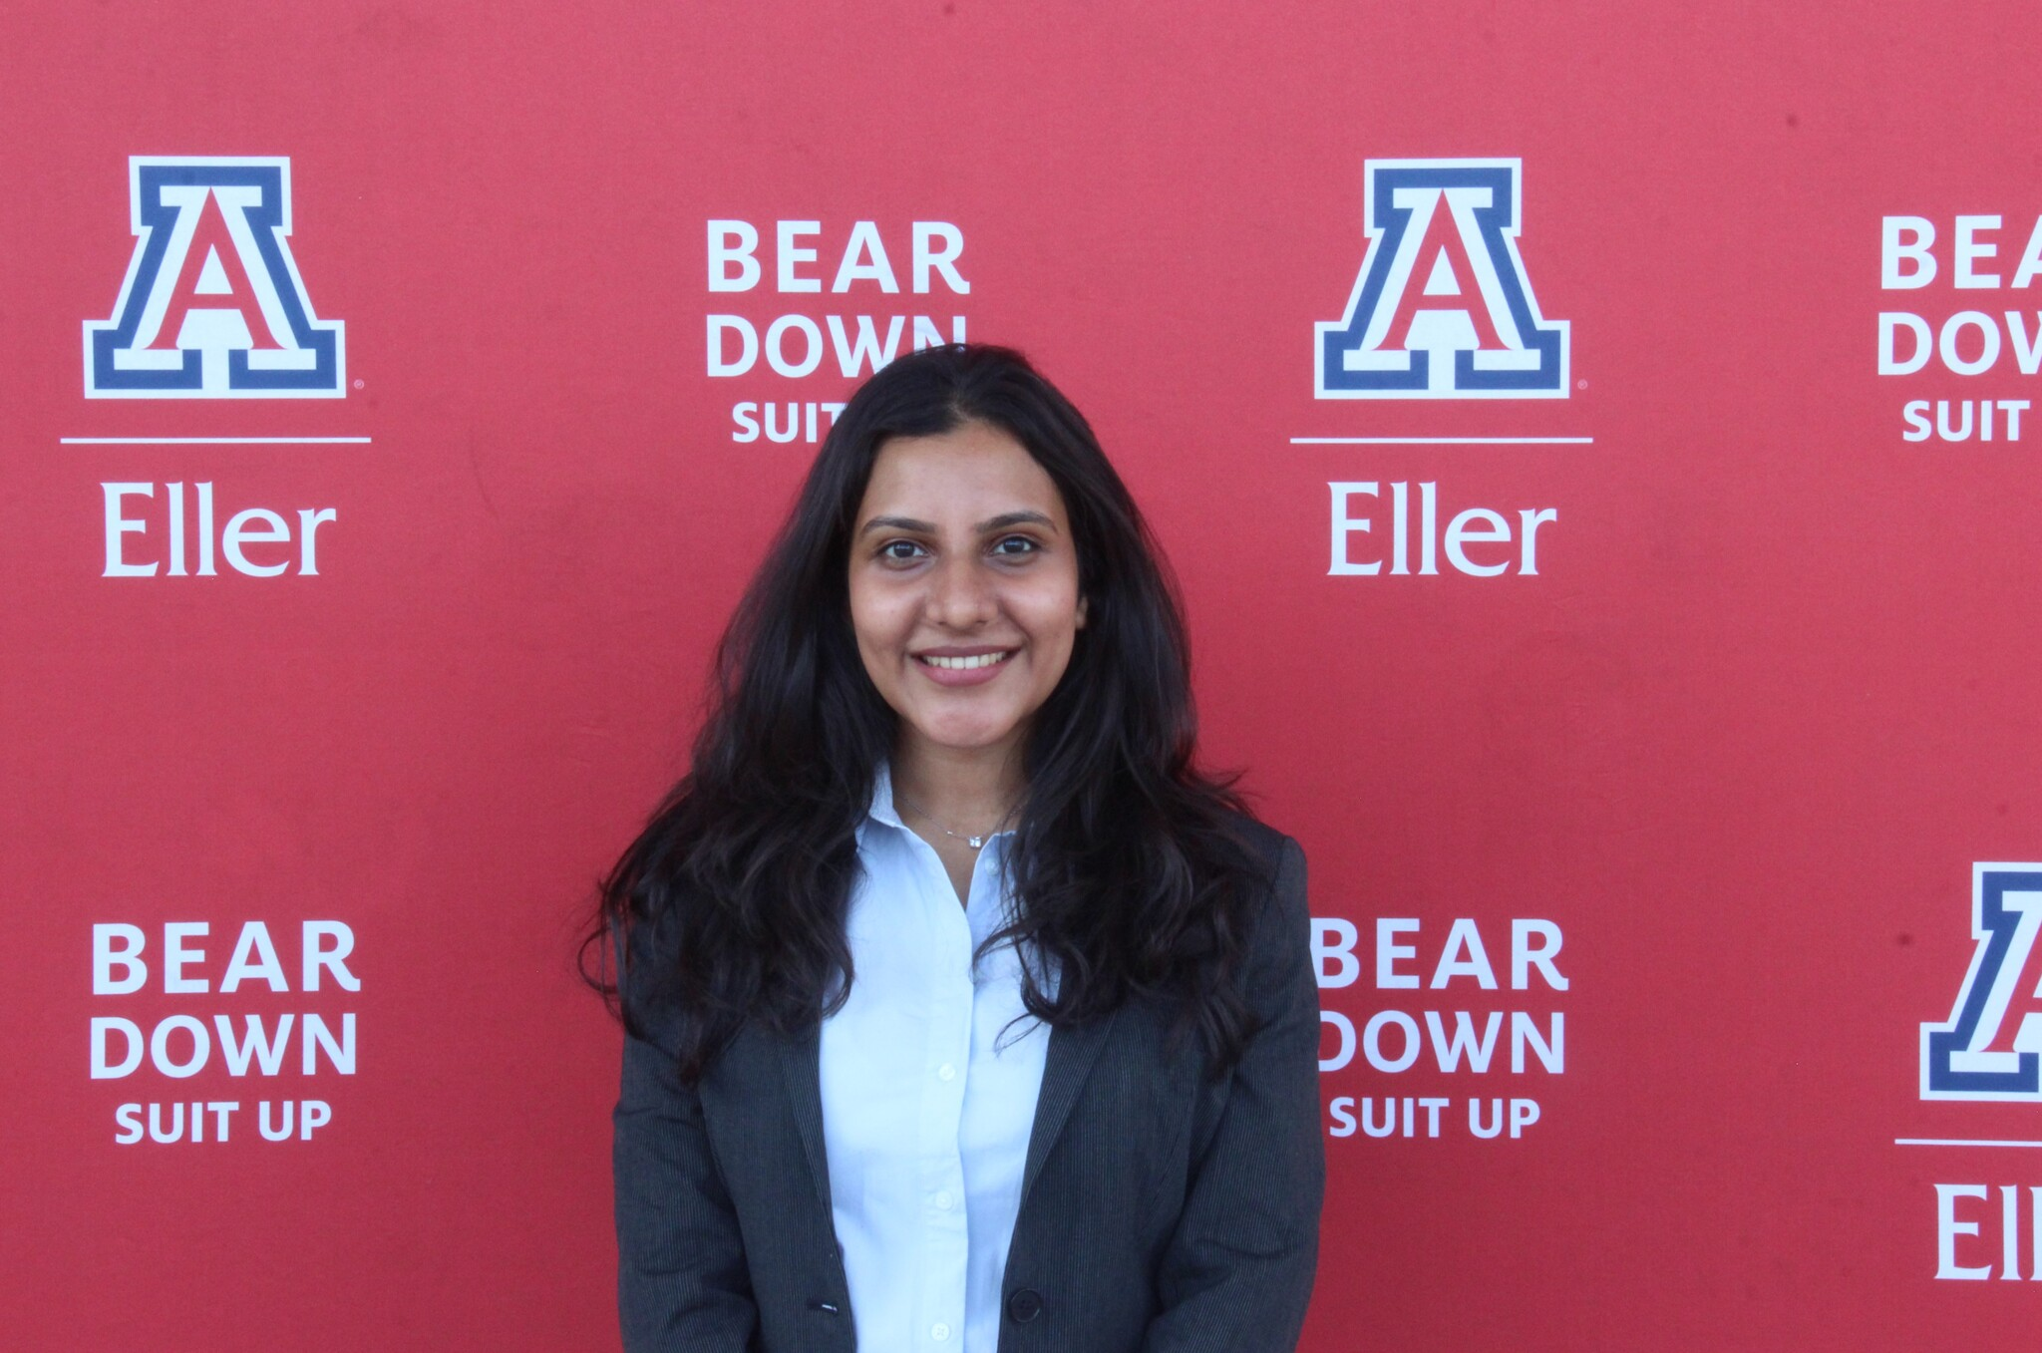


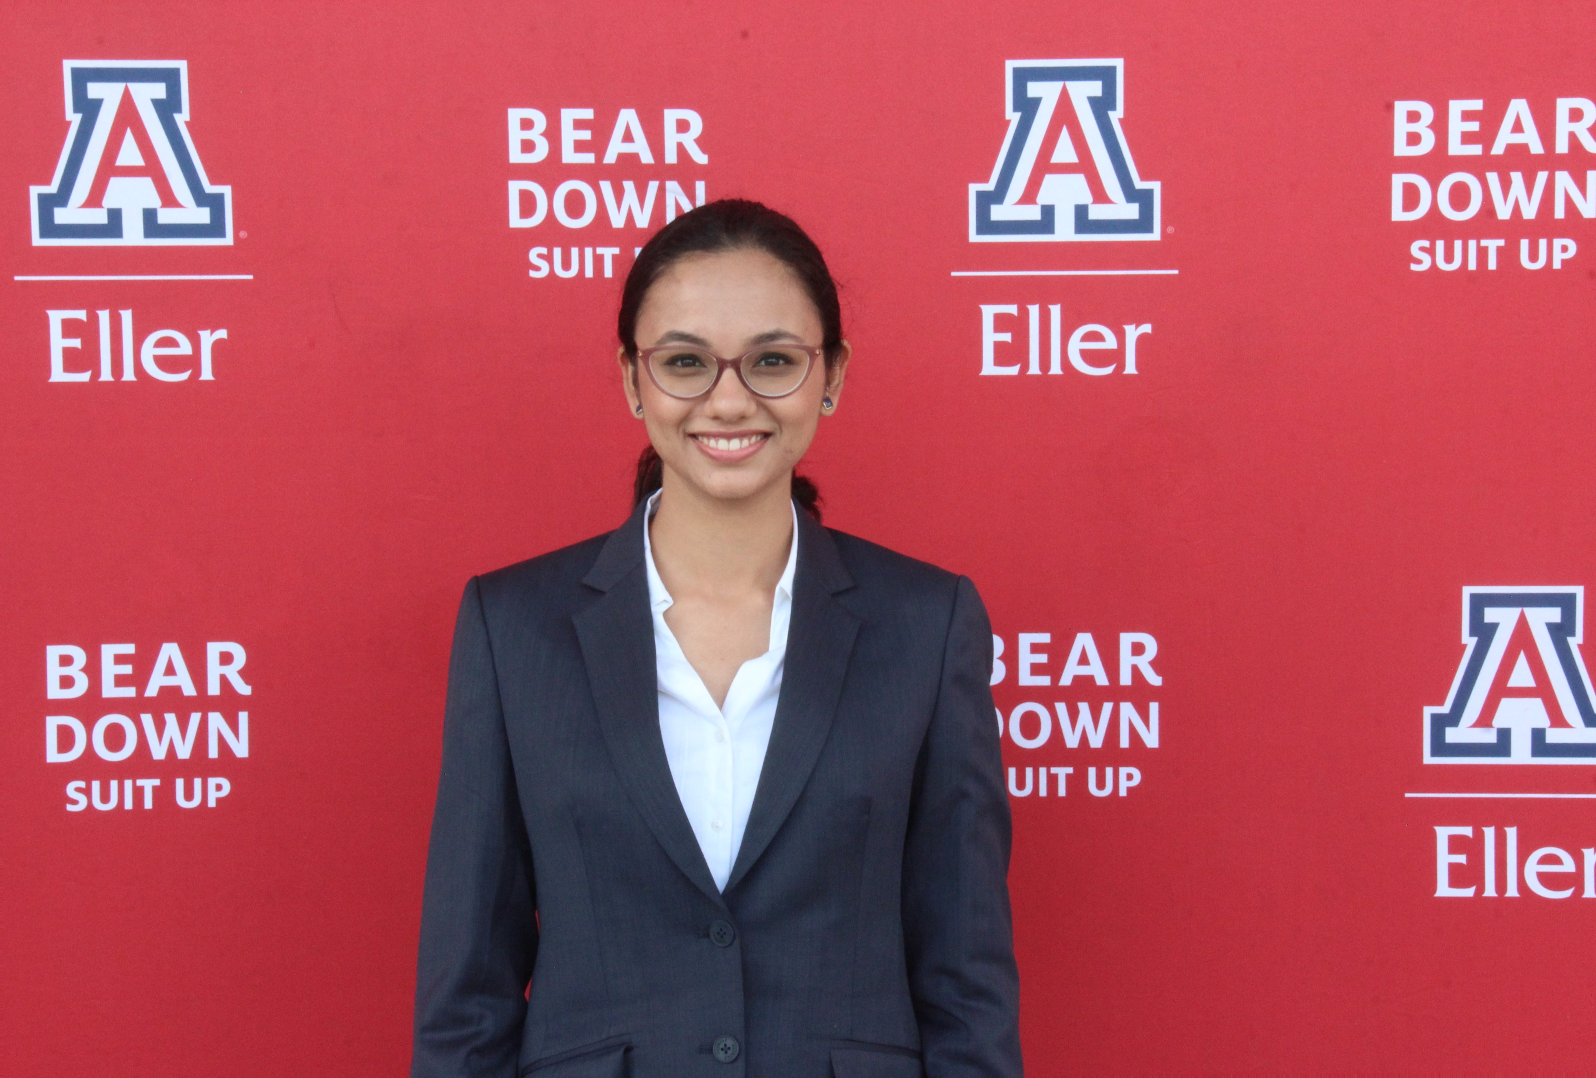
Group Members
Smruti Haragapur
MS-MIS, December 2024
Rishab Karamchandani
MS-MIS, December 2024
Soumya Shah
MS-MIS, December 2024
Ayusha Pendse
MS-MIS, MBA, May 2025

Slide 3




Project Scope and Data Overview
Analyze Citi Bank’s credit card utilization records to assess user behavior and identify churn patterns and at-risk customers to provide actionable insights for retention strategies and data-driven decision making.
Project Scope :
This dataset contains over 10K records representing credit card customers, capturing a comprehensive profile of customer demographics, behavior, and transactional activity.
Data Overview :
User Identification
Customer Demographic
Card Utilization
Transaction Trends
Unique ID
Attrition Status
Age
Gender
Education
Marital Status
Income Bracket
Card Type
Credit Limit
Revolving Balance
Months on Book
Transaction Amount
Q4 vs Q1 Changes

Slide 4
Exploratory Dashboard
Walkthrough - https://drive.google.com/file/d/1Wv7O8pnhMthLSh8KXyET1MbvHYo4B8Le/view?usp=sharing

Slide 5
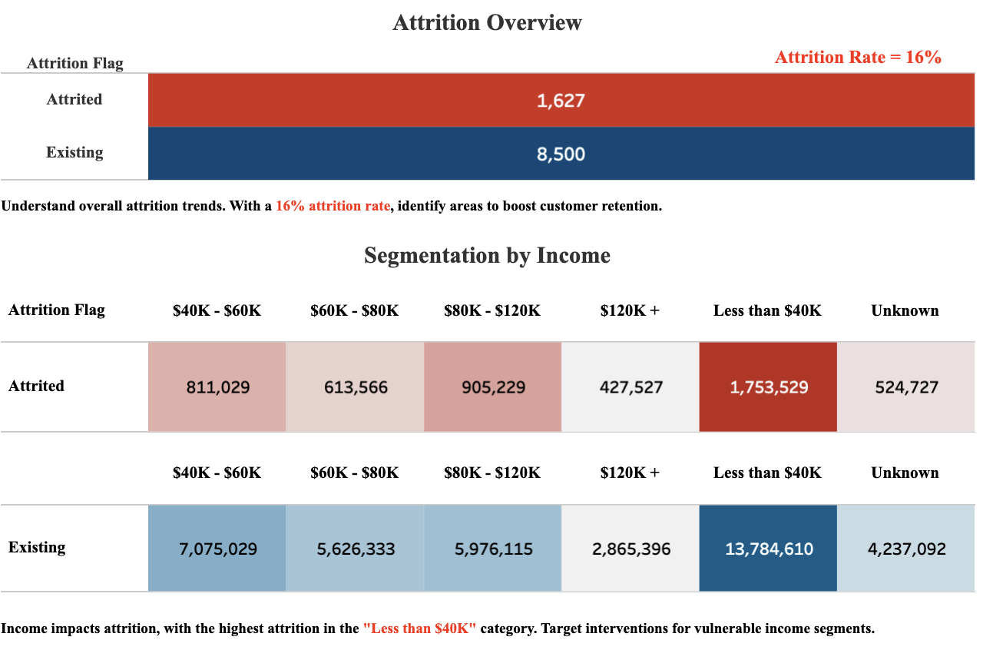
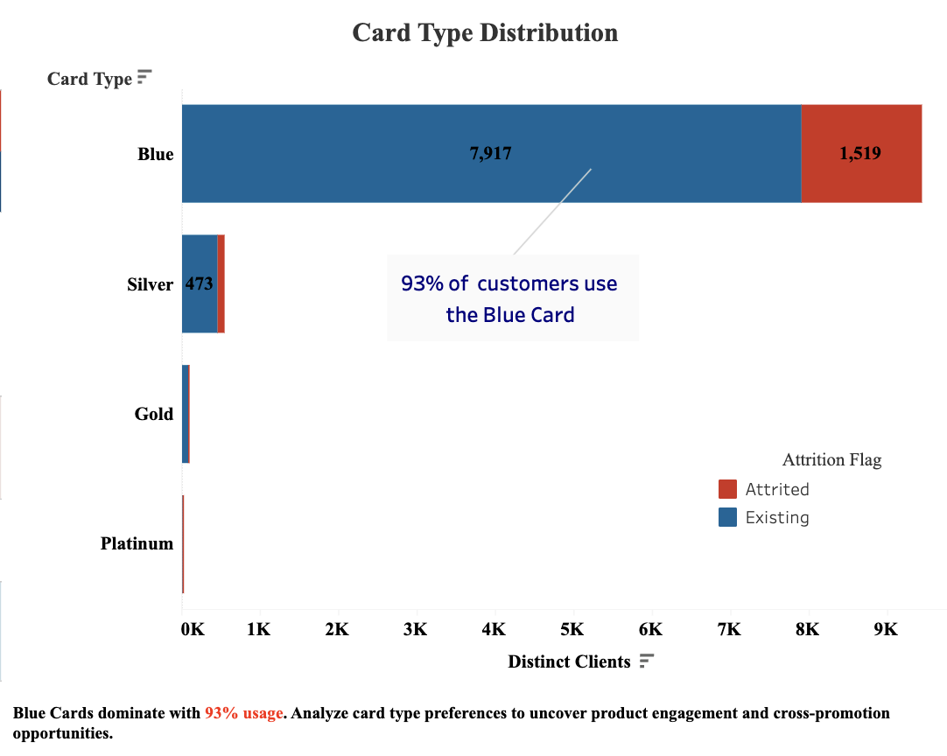
Attrition Breakdown and Card Distribution

Slide 6
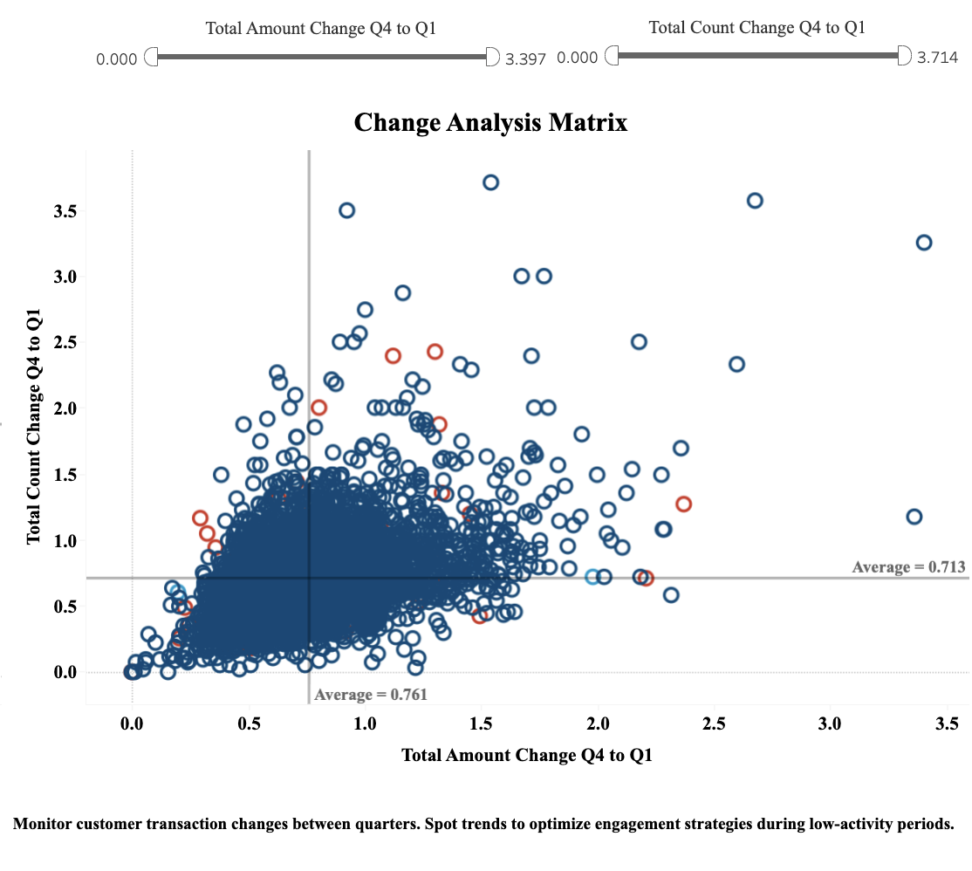
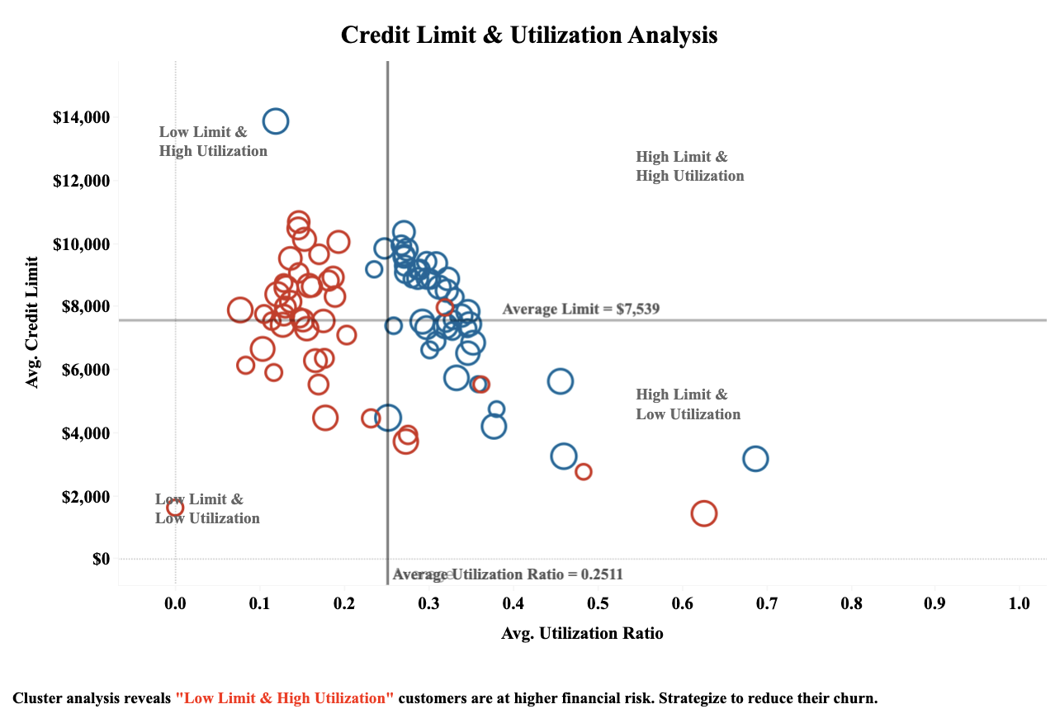
Card Utilization and Change Analysis

Slide 7

Explanatory Dashboard
Kindly refer to the accompanying voiceover for a detailed overview of the upcoming slides

Slide 8
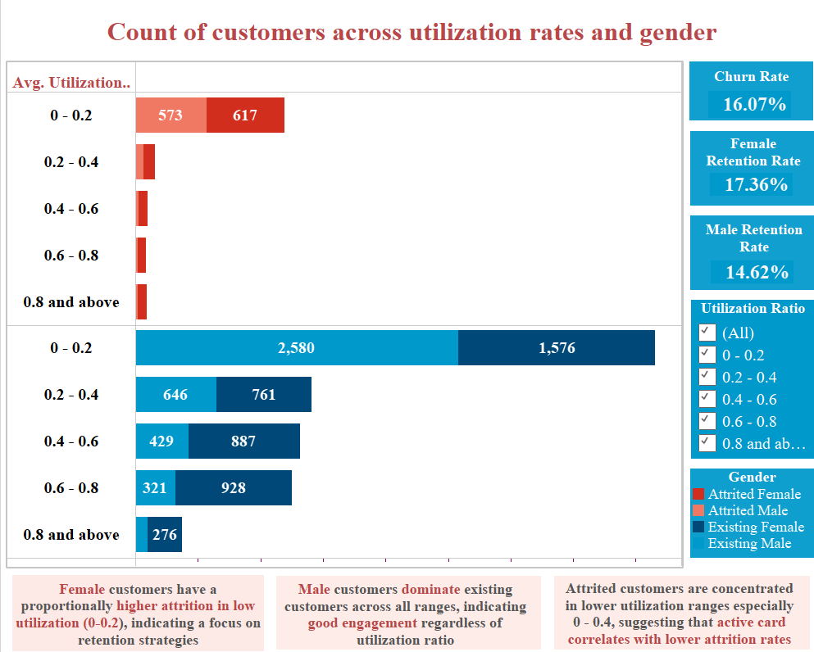
Customer utilization rates segmented by gender

Slide 9
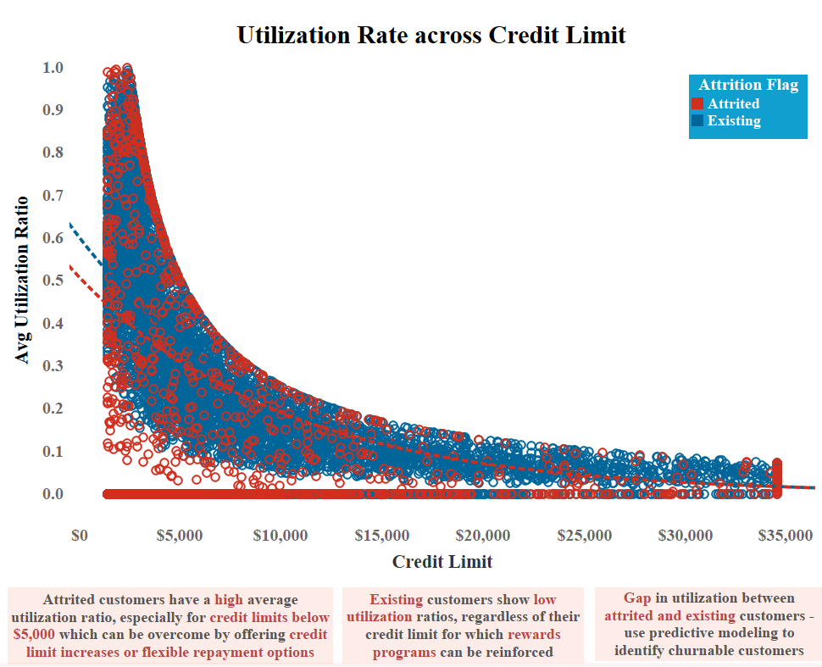
Credit utilization rates segmented by credit limit and attrition status

Slide 10
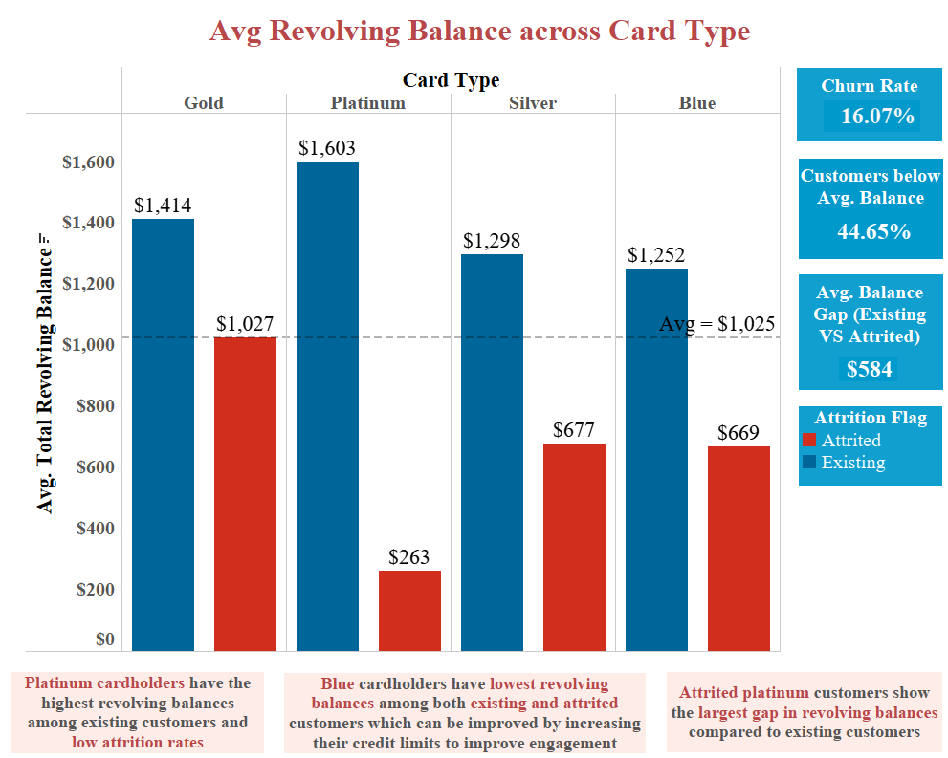
Average revolving balances segmented by card type and attrition status

Slide 11
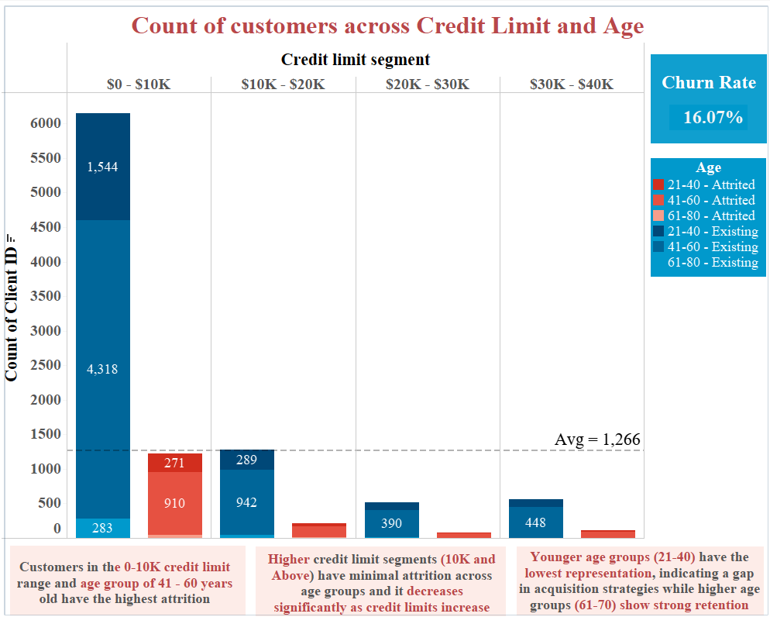
Customer count segmented by credit limit ranges, age groups, and attrition status

Slide 12
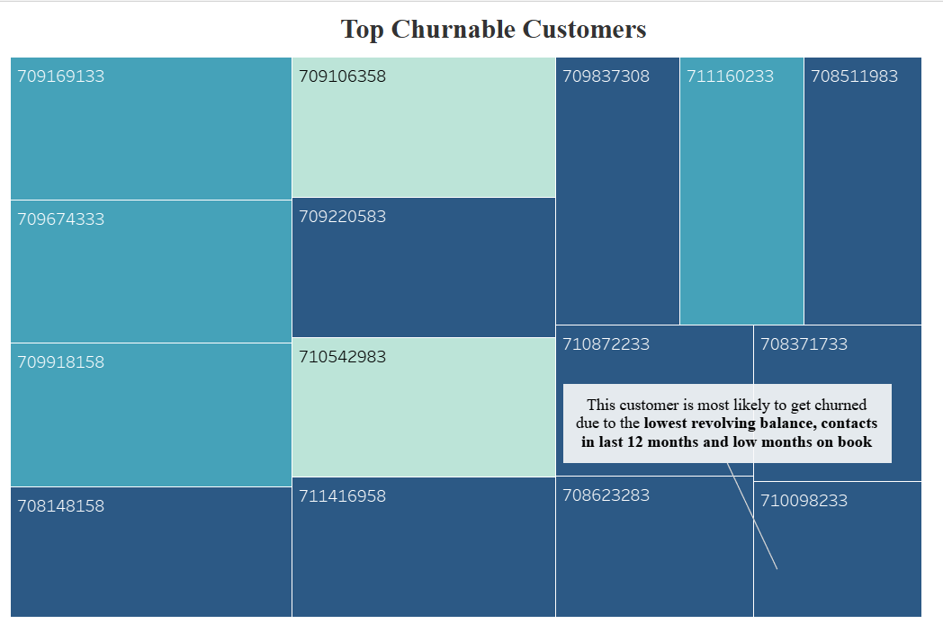
Top churnable customers identified based on revolving balance, recent contacts, and months on book.

Slide 13

Future Scope
Credit Limit Optimization
Enhanced Churn Prediction Models
Introduce flexible credit limit adjustments for at-risk customers to improve financial engagement and reduce attrition.
Develop predictive models using advanced machine learning techniques to identify customers with a high likelihood of attrition
Behavioral Analysis Expansion
Dynamic Retention Strategies
Analyze additional variables like spending categories or repayment trends for deeper insights.
Tailor retention campaigns based on customer segmentation, such as gender, age groups, and credit utilization patterns.
Real-time Monitoring
Customized Engagement Plans
Implement dashboards for continuous tracking of utilization patterns, revolving balances, and customer engagement.
Focus on low-utilization customers (e.g., females with utilization < 0.2) by offering rewards or personalized incentives.

Slide 14
Contact Information
Tableau link
https://public.tableau.com/app/profile/soumya.shah6876/viz/MIS561FinalProject/FinalSTORY
Thank You!
For further information, please reach out to :
smrutikh@arizona.edu
rishabk@arizona.edu
soumyashah@arizona.edu
ayushapendse@arizona.edu

